Slide 1
MINESWEEPER
Team members:
1. Nguyễn Hoàng Linh – ITITIU19023
2. Trần Hoàng Long – ITITSB19004
3. Nguyễn Đức Minh – ITITIU19030
4. Trần Quang Tùng – ITITIU19237

Slide 2
Contribution
Linh
Long
Minh
Tùng
+ Handle flow of the app
+ Manage API
+ Advanced features
+ Handle events
+ Create user interface
+ Handle events
+ Create leaderboard
+ Handle events
25%
25%
25%
25%

Slide 3
Contents
01
User interface
Beautiful user interface for minesweeper app
02
Game rules
Rules and interesting features for the game
03
Class diagram
Represent all classes in the code by class diagram
04
Design Pattern
Make the code more organized by design patterns
05
Data structures and algorithms
All the powerful logic handle for the app

Slide 4
User Interface

Slide 5
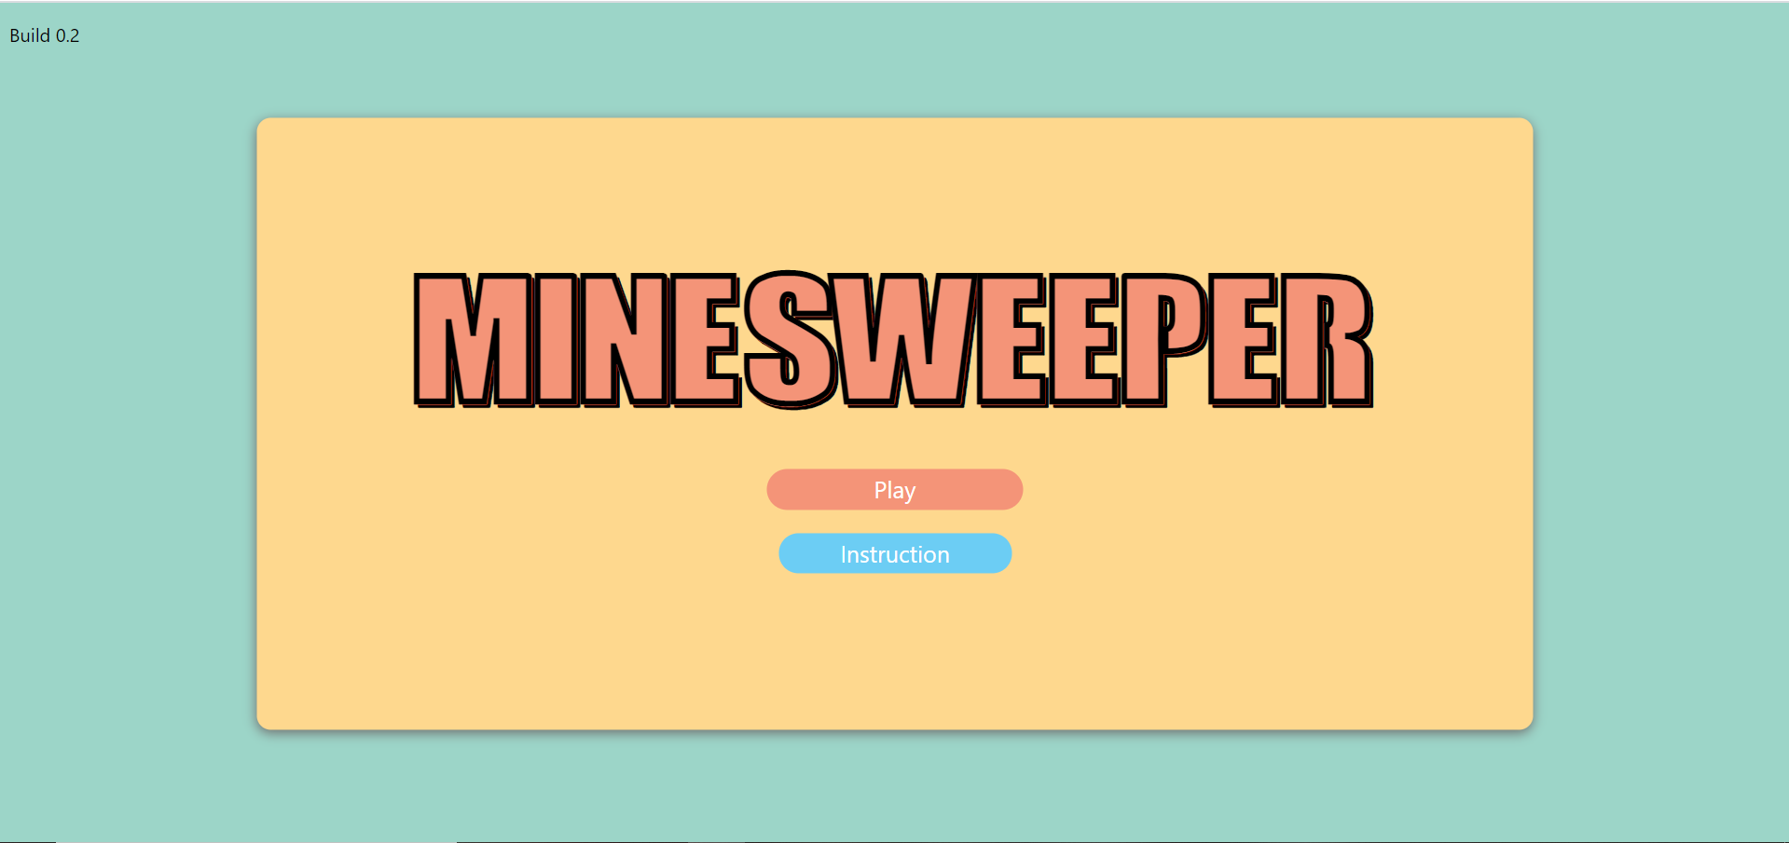
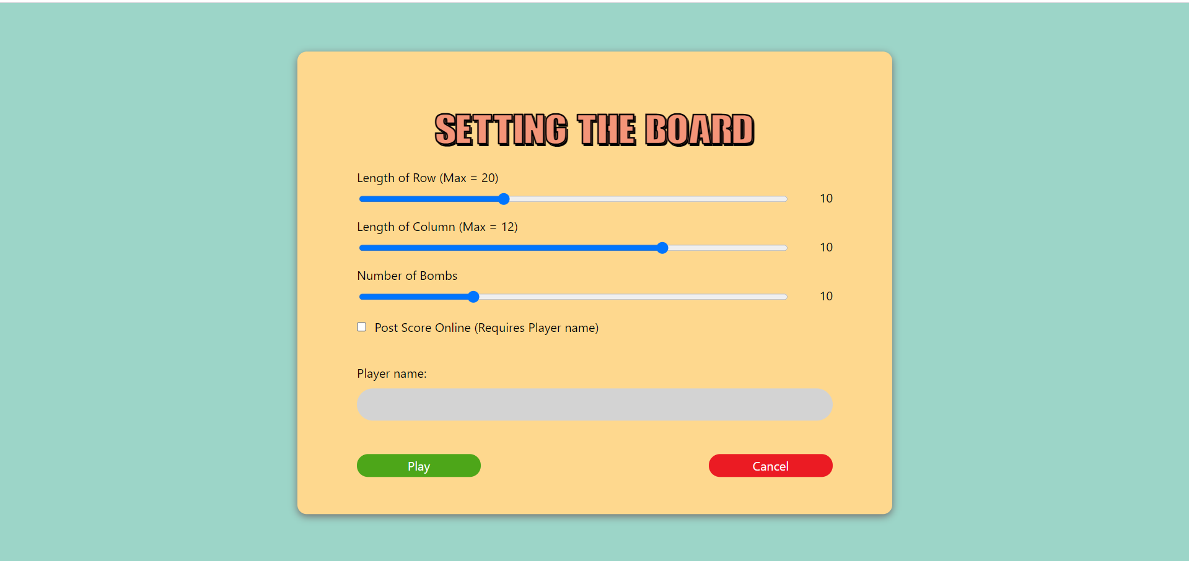
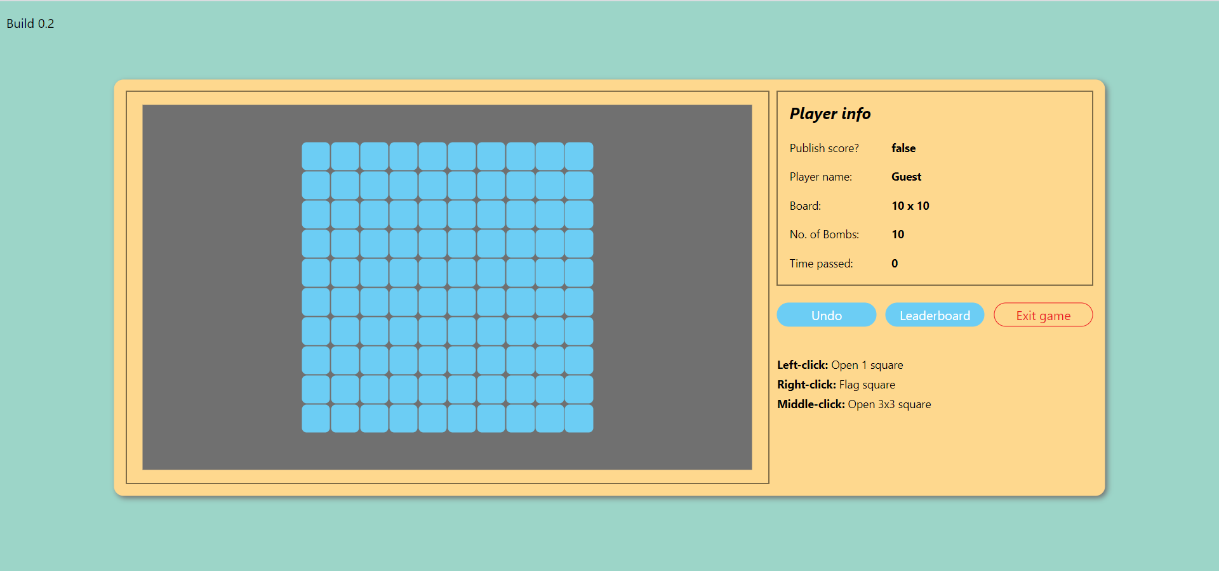
3 main screens
Main Menu
UI is built on HTML, CSS, and JavaScript (JS).
HTML – building raw components on the page
CSS covers all button and input field animations (animated states such as hover, focus, disabled)
Front-end logic are dealt with using JS
Color wheel for consistency.
Adobe XD:
Graph out the look of the webapp,
Apply colors
Positioning of components
Settings
Game

Slide 6
Main Menu
Custom font and styling
Animation
Hyperlink

Slide 7
3 main screens
Main Menu
UI is built on HTML, CSS, and JavaScript (JS).
HTML – building raw components on the page
CSS covers all button and input field animations (animated states such as hover, focus, disabled)
Front-end logic are dealt with using JS
Color wheel for consistency.
Adobe XD:
Graph out the look of the webapp,
Apply colors
Positioning of components
Settings
Game

Slide 8
Settings
Slider for board size config
Value indicator – changes in real-time
Checkbox to confirm score publish
Enabled if checkbox is checked
Confirm config and Play
Return to Main Menu

Slide 9
3 main screens
Main Menu
UI is built on HTML, CSS, and JavaScript (JS).
HTML – building raw components on the page
CSS covers all button and input field animations (animated states such as hover, focus, disabled)
Front-end logic are dealt with using JS
Color wheel for consistency.
Adobe XD:
Graph out the look of the webapp,
Apply colors
Positioning of components
Settings
Game

Slide 10
Settings
Minefield – play area
Player info area
Load leaderboard from JSON

Slide 11
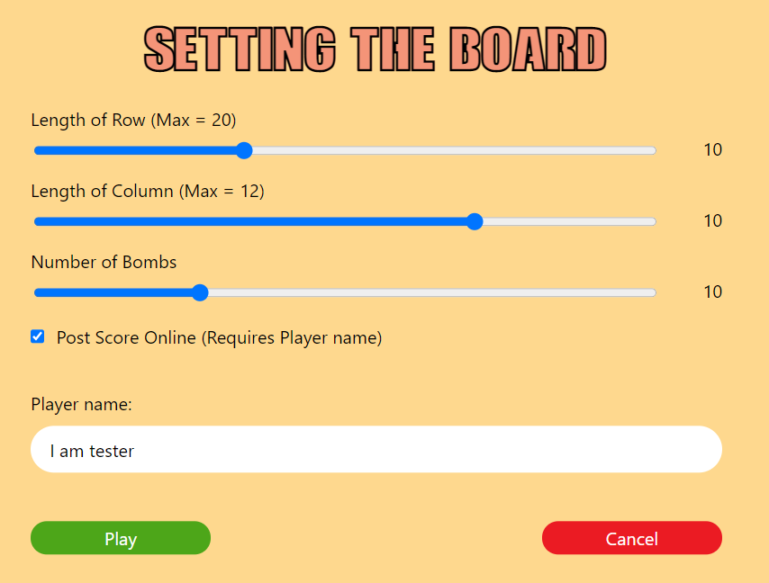
II. Game rules
Choose the dimensions of the grid and number of bombs.
Click on the box “Post Score Online” to save score
Board setting

Slide 12
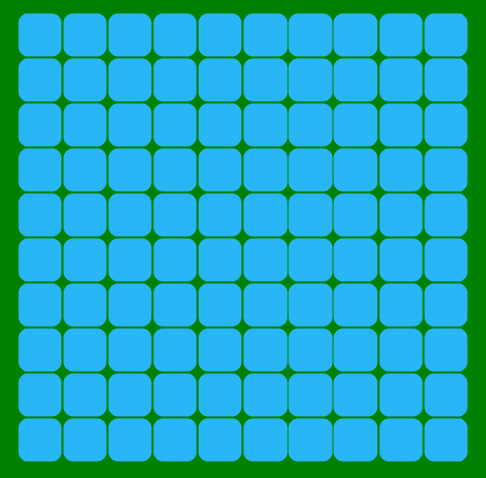
II. Game rules
Choose the dimensions of the grid and number of bombs.
Click on the box “Post Score Online” to save score
The gird will show on the screen
The grid

Slide 13
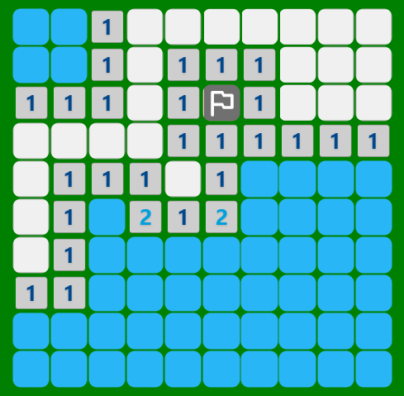
II. Game rules
Choose the dimensions of the grid and number of bombs.
Click on the box “Post Score Online” to save score
The gird will show on the screen
Open cells as many as possible, but avoid the bombs
Example for cells

Slide 14
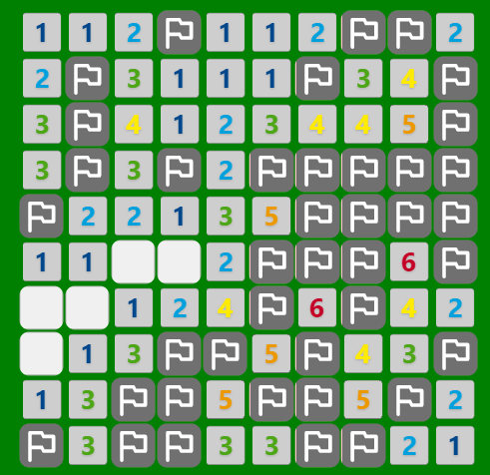
II. Game rules
Choose the dimensions of the grid and number of bombs.
Click on the box “Post Score Online” to save score
The gird will show on the screen
Open cells as many as possible, but avoid the bombs
The player can put on a flag on each cell by using right click
All non-bomb cells opened → Win
Player win

Slide 15
III. Class diagram
1. API
When a website requests data from our API, that API will return a 2D array containing the necessary information.
To be able to control this API, users need to operate directly on the following URL:
https://myapi-minesweeper.herokuapp.com/

Slide 16
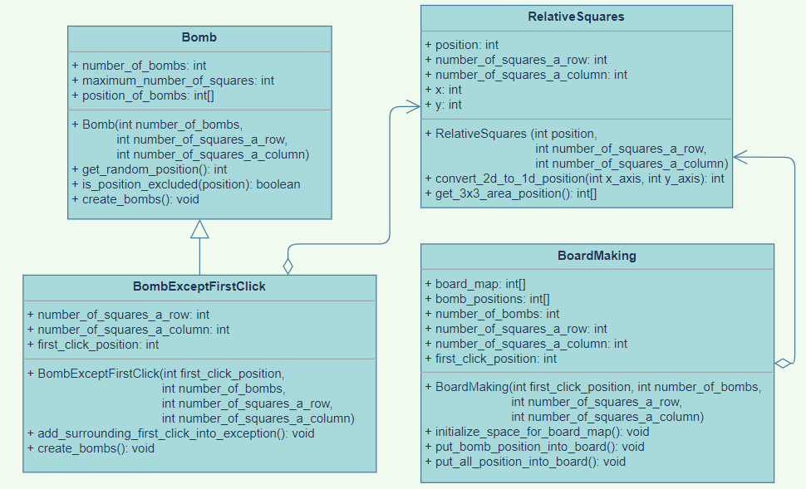
III. Class diagram
1. API

Slide 17
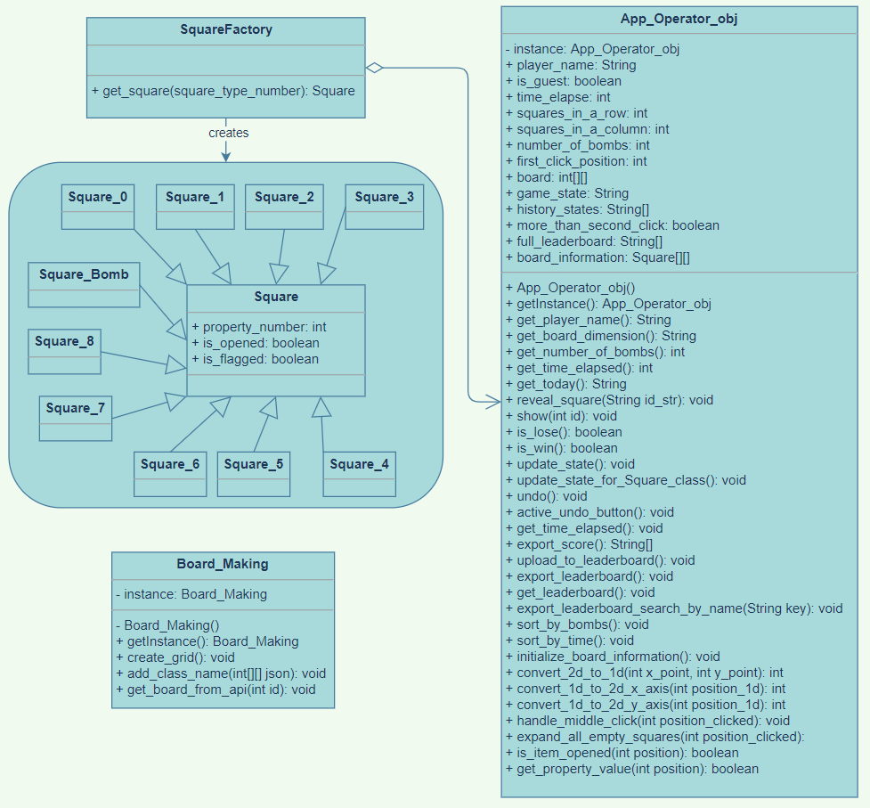
III. Class diagram
2. Main app

Slide 18
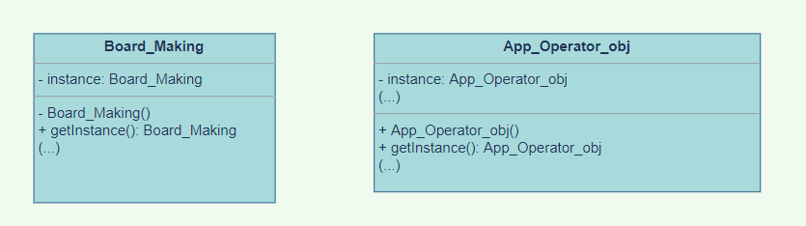
IV. Design Pattern
1. Singleton Pattern
We have 2 classes that manage the entire system as creating the board, recording the state of the cells, or checking if the player win or lose
Accessing and storing information.
→ Use Singleton Pattern

Slide 19
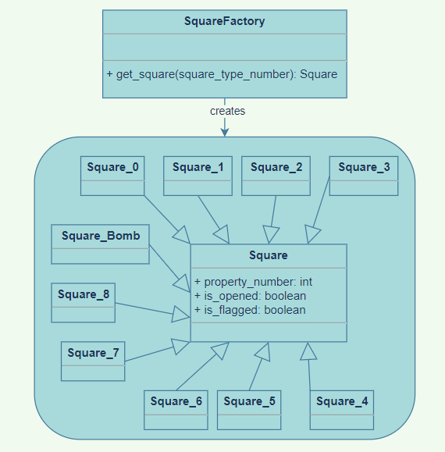
IV. Design Pattern
2. Factory Pattern
We have many classes for different types of cells, for example cells with bombs inside, or cells with 7 bombs around.
To be easier to create objects for each cell, we need a class that can create 10 different types of objects using different parameters
→ Use Factory Pattern

Slide 20
V. Data structures and algorithms
1. Data structures
Two-dimensional array: store information of the grid
One-dimensional array: contain 1D coordinates, support Stack
Stack: support Undo feature
Queue: support Breadth First Search

Slide 21
V. Data structures and algorithms
2. Algorithms
Time counter
minute = seconds_elapsed / 60
second = seconds_elapsed % 60
Self-adjust number of bombs
Max number of Bombs = (Row length * Column length) – 10
Checking if player loses
A cell contains bomb opened by user → Lose
Checking if player wins
Cells_are_not_bomb = (Row_length * Column_length) – Bomb_number
Opened cells >= Cells that are not bomb AND Bomb cells not opened → Win

Slide 22
V. Data structures and algorithms
2. Algorithms
Undo move
Player click → Update and record all the cells → Put them in a stack
Player wants to undo → Pop out the stack and get the old information → Revert state of all cells
Creating the random bombs
Probability for clicking a cell with bomb at the first time = 0%
Minimum position = 0
Maximum position = Row length * Column length – 1
→ Range for position of bombs = [0, Row length * Column length – 1]

Slide 23

Linear Search
Algorihm
-First, we use entry() function to clear all contents in leaderboard.
-Next, Linear algorithm will checked every item and if a match is found then that particular item is returned, otherwise the search continues till the end of the data collection.
-This function’s structure is just 1 simple loop with condition statements to add every piece of data (play_name, board_dimension, num_of_bombs, date, time_elapse, game_state) into leaderboard_table. Then appending row_element into leadboard_table.

Slide 24
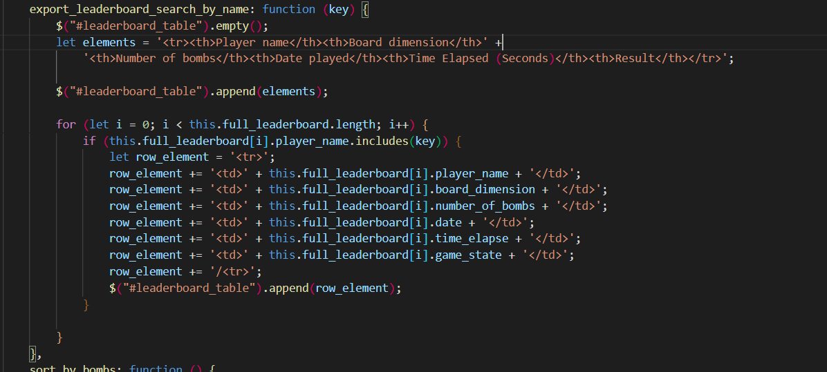
Linear Search:
Figure. Linear Search Algorihm

Slide 25
Insertion Sort
- In section sort_by_bomb and sort_by_time we use insection sort to serialize time và bombs according to the number of of bom and time after each game
This function’s structure include 2 loops for and while:
+ In ”for” statement, it will run respectively from the first to the last element of subarray;
+with loop while, it will reloctae elements having bigger value than “current” values to after its original position

Slide 26
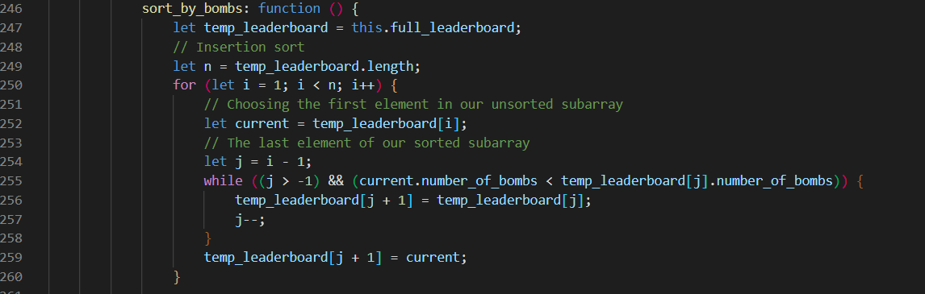
Figure. Sort_by_bombs function

Slide 27
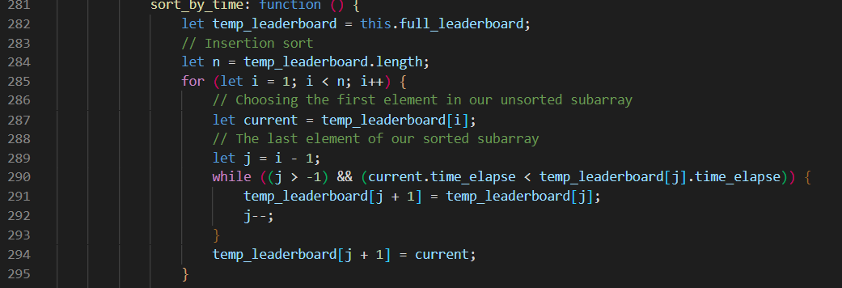
Figure. Sort_by_time: function

Slide 28
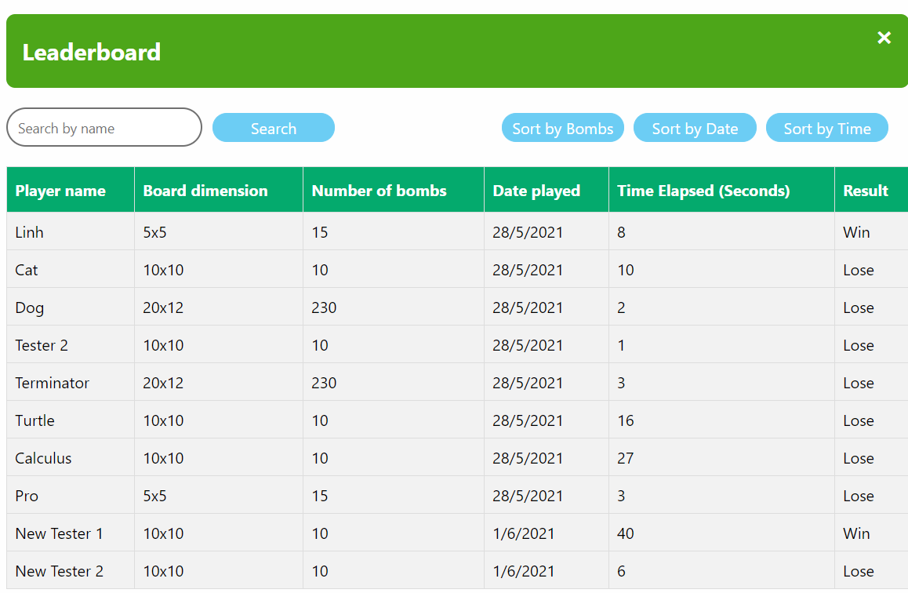
Using Insertion Sort with bombs and time will make leaderboard become clear and easy to find the results and rankings after each game.
Figure. Leaderboard

Slide 29
Middle click function
Reveal all the 3x3 area around the chosen click position.
Activate condition: When the number of flags in surrounding area (3x3 area) is equal to the value of the clicking cell
This function’s structure:
2 simple loops
Validate that the new generated position values do not go off bounds of the game board.

Slide 30
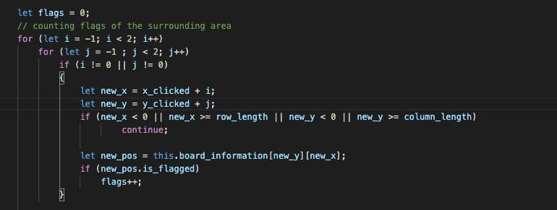
Figure. Couting number of flags of 3x3 area

Slide 31
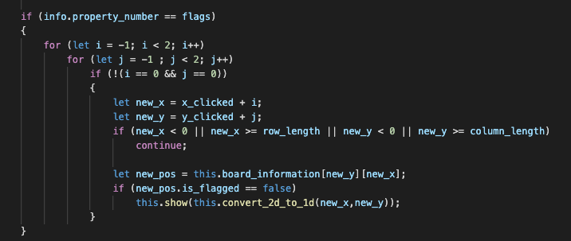
Figure. Open surrounding 3x3 area

Slide 32
Expand all empty function:
Activate Condition: Chosen position -> value of 0 (an empty white cell on the GUI).
Expand all the adjacent 0 cells until -> value larger than 0.
The algorithm: BFS (Breadth-First Search) running on a 2D array.
We use a Queue to store the positions that have potential to keep extending.
”Visited” array.

Slide 33
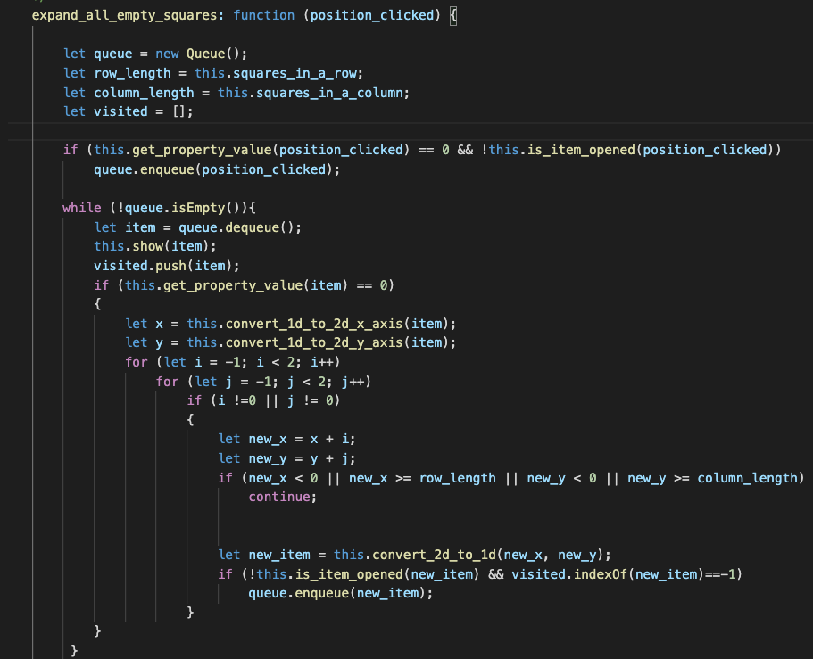
Figure . Find all empty cells using BFS.

Slide 34
Thank you

